Slide 1

Energy-Efficient D2D Based Multicast Communication Through Channel Allocation Scheme
B.K.Vasavi
17MT8317
M.Tech(DECS)
Under the Guidance of
C.M.Sripriya,
Asst.Prof,
Department of ECE.

Slide 2
CONTENTS
Abstract
Introduction
Existing method
Proposed method
Extension
Conclusion
References

Slide 3
Abstract
In the traditional reliable multicast schemes of wireless cellular network, base station (BS) repeatedly transmits the same packet until it is received by all receivers. The use of device-to-device (D2D) communication can greatly offload the traffic of BS.
This paper considers D2D communication based multicast from BS to a cluster of devices which are close to one another. So far, the efficient D2D retransmission scheme available is to associate each NACK-device to some near ACK-device for forming sub clusters, and let ACK-devices retransmit the data to their respective associated NACK-devices in the FDMA mode by using multiple channels, aiming to minimize the time frequency resource cost.
Finally, we propose an efficient algorithm for this problem to find a good association pattern and transmission powers. Simulation results show that, using D2D communication greatly reduces multicast traffic load of BS.

Slide 4
Introduction
In recent years, the amount of traffic in wireless cellular network (WCN) has been rising rapidly.
In the traditional reliable multicast schemes of WCN, base station (BS) repeatedly transmits the same packet until it is received by all receivers, resulting in heavy multicast traffic load.
Therefore, it is very important to develop efficient multicast schemes for WCN, which are able to effectively reduce the data retransmissions conducted by BS while guaranteeing the desired performance level with respective to packet delivery .

Slide 5
Existing Methods
1) Zhang method :
Selection of fixed number of receivers before transmission.
Primary receivers are responsible for retransmission.
Base station
Primary receivers
NACK devices

Slide 6
Continue…
2) Zhau method :
The sub cluster based D2D retransmission scheme proposed.
FDMA Mode is used for Retransmission
Sub cluster consists:
Base Station
ACK device
NACK device

Slide 7
Drawback of existing methods
In the case that one or several receivers having lost packets are relatively far from all primary receivers, the number of retransmissions is large due to the bad D2D retransmission links.
Uses multiple channels for data transmission.

Slide 8
Proposed Method
Sub Cluster Based Single channel D2D Retransmission.
Base station transmits the packet to cluster of Devices.
Ack devices will retransmits the packets to NACK devices.
Retransmission is done in TDMA mode

Slide 9
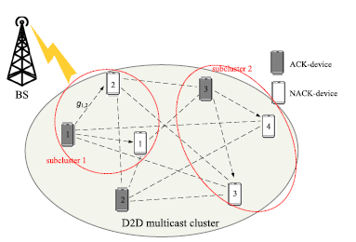
Representation of our method

Slide 10
Continue…
The two major problems in the above scheme:
Selection of NACK Devices AP
Optimization of Retransmitter’s Transmission powers.
Solutions:
HEURISTIC Algorithm –selection of NACK devices associative pattern.
MNLP Algorithm –optimization of transmission powers.

Slide 11
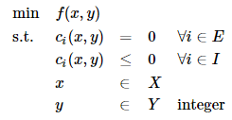
MINLP Algorithm
Mixed integer nonlinear programming (MINLP) refers to optimization problems with continuous and discrete variables and nonlinear functions in the objective function and/or the constraints. MINLPs arise in applications in a wide range of fields, including chemical engineering, finance, and manufacturing. The general form of a MINLP is

Slide 12
Heuristic Algorithm
A heuristic algorithm is one that is designed to solve a problem in a faster and more efficient fashion than traditional methods by sacrificing optimality, accuracy, precision, or completeness for speed.
Heuristics can produce a solution individually or be used to provide a good baseline and are supplemented with optimization algorithms. Heuristic algorithms are most often employed when approximate solutions are sufficient and exact solutions are necessarily computationally expensive.

Slide 13
Advantages :
Through extensive simulations, we show that, on one hand, the use of D2D communication greatly reduces the multicast traffic of BS.
On the other hand, compared to its counterparts with a fixed number of D2D Retransmitters, the proposed retransmission scheme greatly reduces the total energy consumption of Retransmitters.

Slide 14
Rayleigh fading channel
The magnitude of the signal will vary randomly.
Uses the Doppler shift Concept.
The channel fading depends on the motion of TX and RX.
There are two methods for Rayleigh fading model :
jakes’s model.
Filtered White Noise Model.

Slide 15
Applications of Rayleigh fading channel :
Reasonable model for Tropospheric and Inospeheric signal propagation.
Used for building of Radio signals in Urban Environment.
Most Applicable model when there is no LOS
propagation.

Slide 16
Extension
In this method, we devise a channel allocation scheme using partial information of device locations. For this, we derive the outage probability and an effective throughput of D2DC communications in approximate forms.
The algorithm we proposed here is a practical channel allocation (CA) scheme using partial information of device locations (CA-PIL).

Slide 17
Continue…
As the battery energy of wireless devices (like smart phones) is very limited, we aim to minimize the total energy consumption (EC) of retransmitters.
The difference of optimization goal and the joint design of AP selection and transmission power control make our retransmission scheme design problem greatly different from that in existing methods.

Slide 18
Advantages :
Compared to its counterparts with a fixed number of retransmitters, our retransmission scheme greatly reduces the total energy consumption of retransmitters.
Also, the energy saving gain increases with an increase in the number of multicast receivers or the number of ACK-devices.
Additionally, this work assumes that BS has knowledge of the instantaneous channel power gains of D2D links.

Slide 19
Applications :
In 5G networks.
D2D communications regarding public safety applications such as search and rescue missions, coverage extension, and road safety.
Mission critical application is one of the most significant applications of D2D communication.
D2D communication can be implemented in IoT applications for low power mesh networking and smart sensor clouds.

Slide 20
Conclusion
In this paper, we considered D2D communication based multicast from BS to a cluster of devices which are close to one another, aiming to minimize the total energy consumption of retransmitters.
Then we formulate the joint optimization of NACK-devices‘ association and retransmitters' transmission powers to be an MINLP problem, minimizing the total energy consumption of retransmitters. Finally, we propose an efficient algorithm for this problem to find good association pattern and transmission powers.

Slide 21
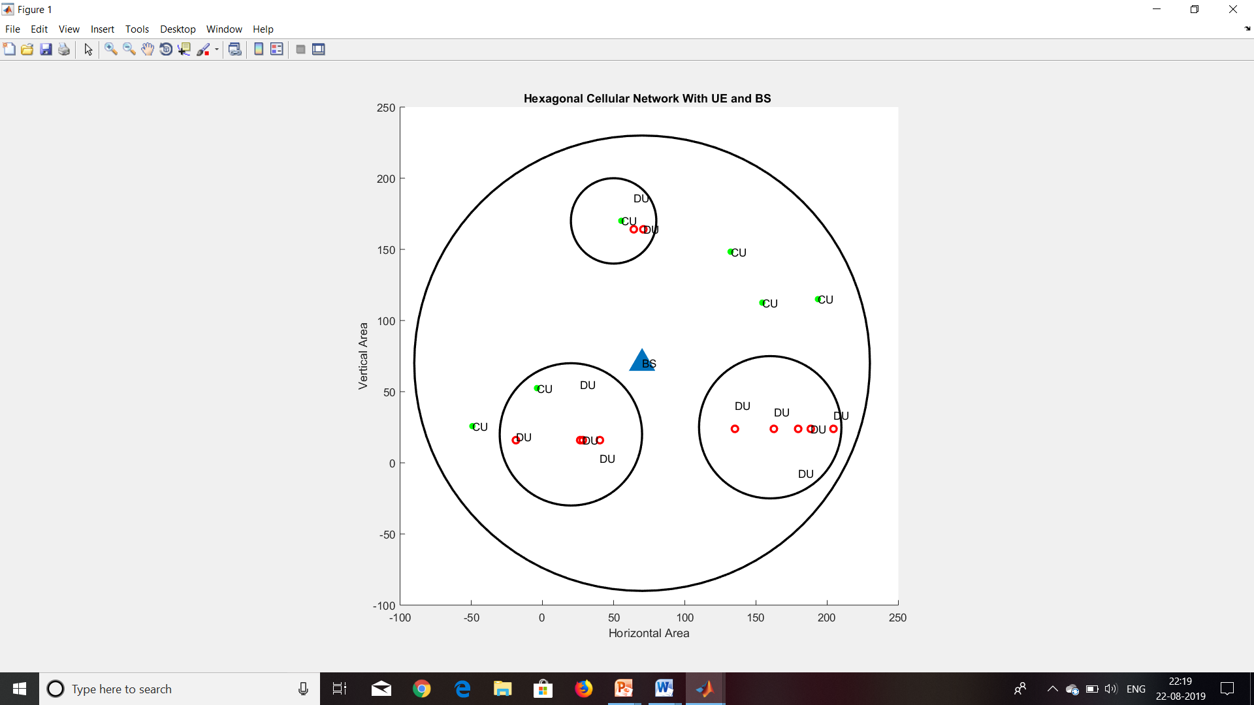
Construction of Cellular Network

Slide 22
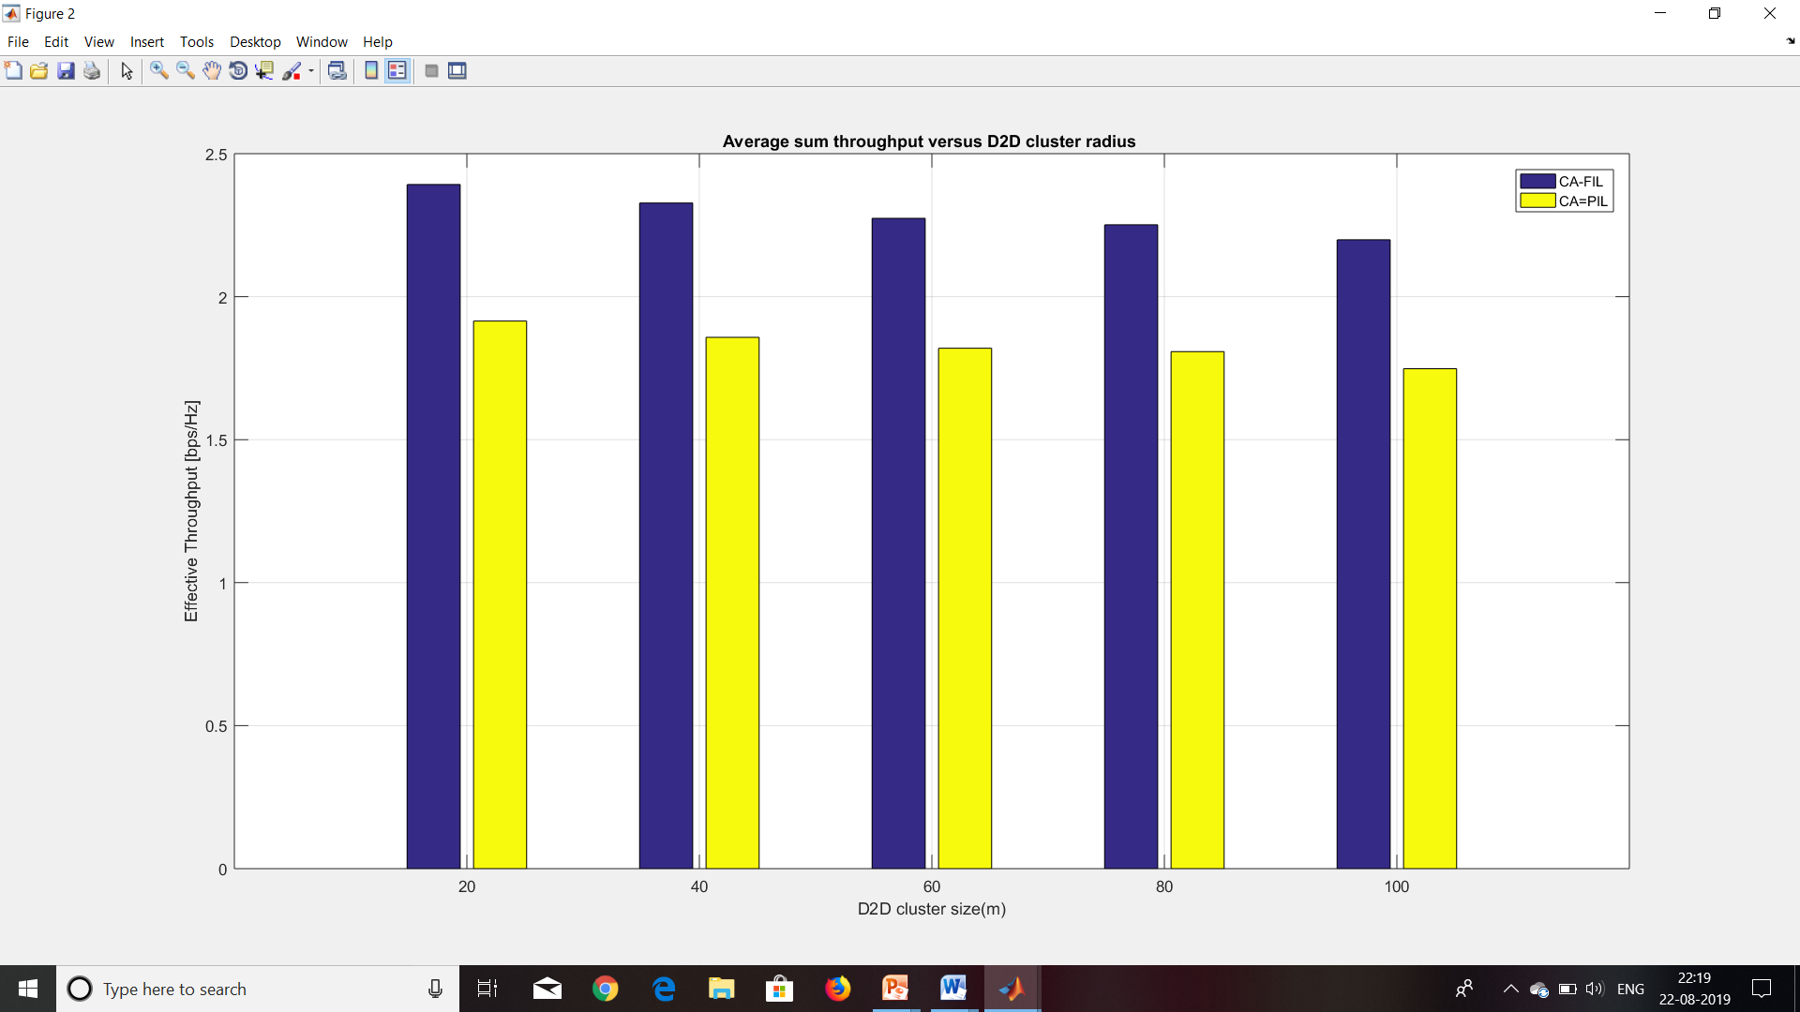
Comparison of Throughputs

Slide 23
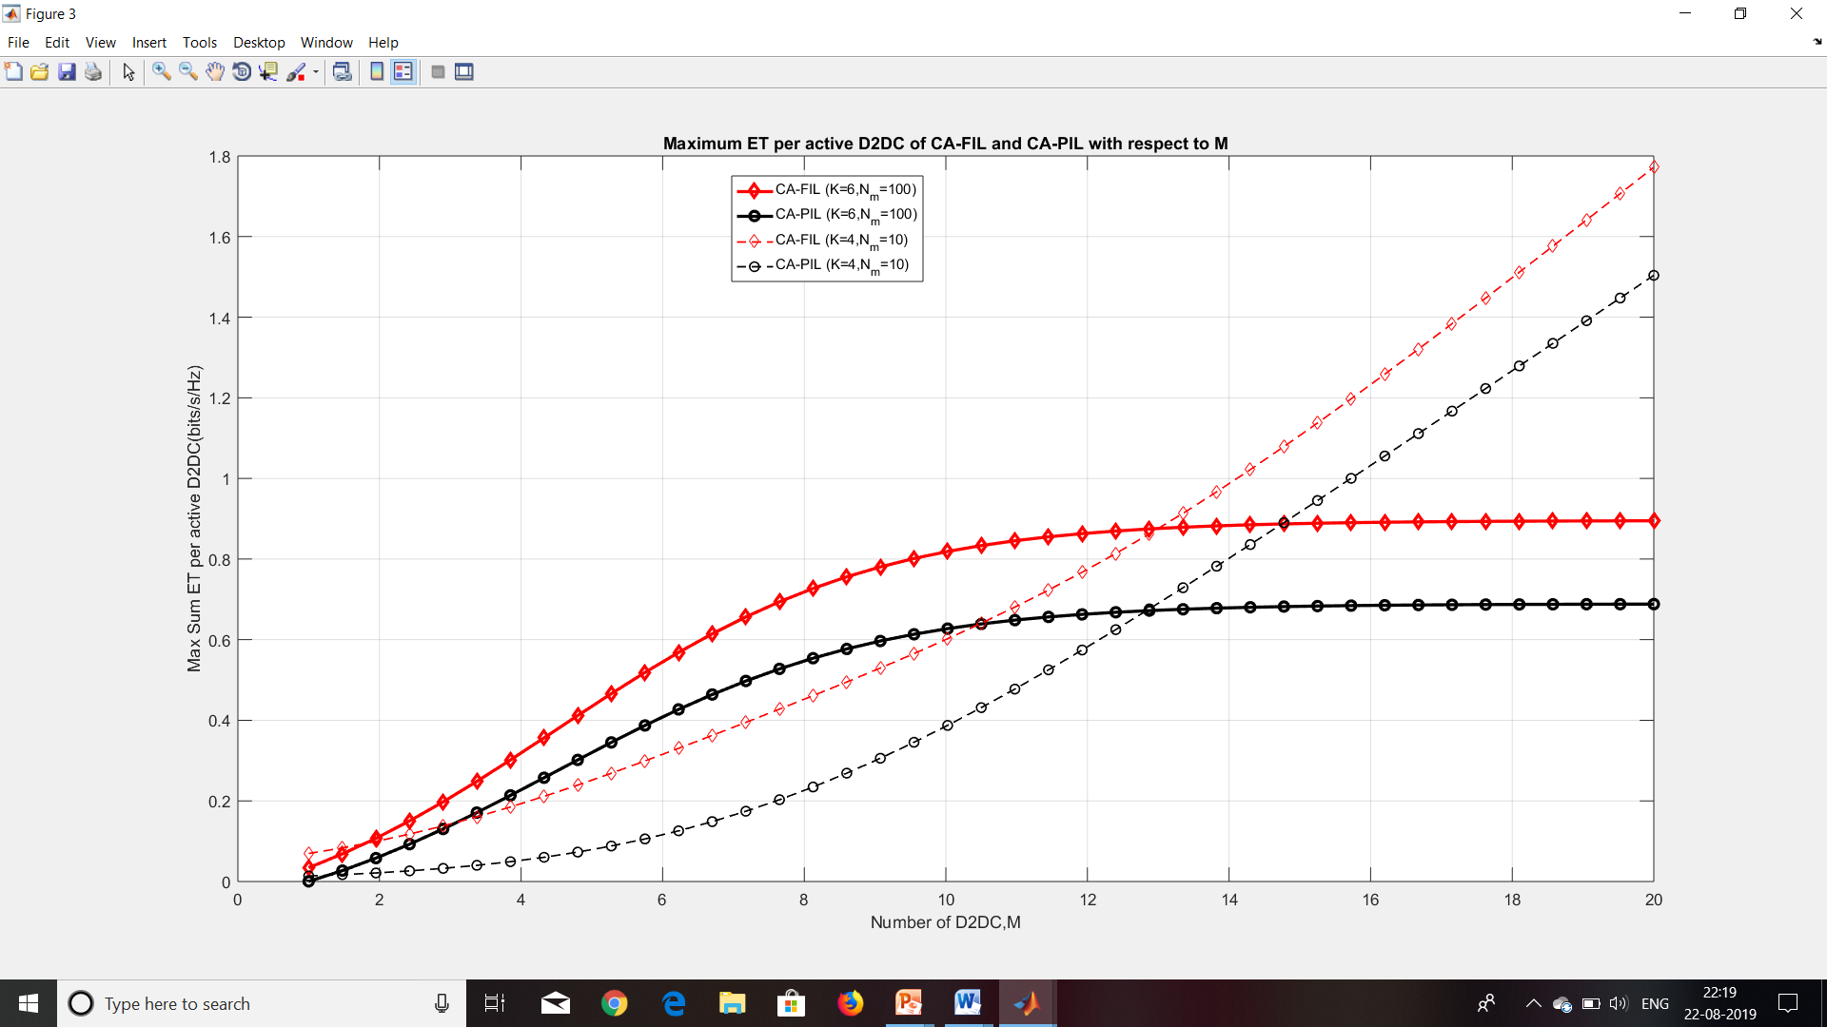
Comparison of ET with increased number of Users

Slide 24
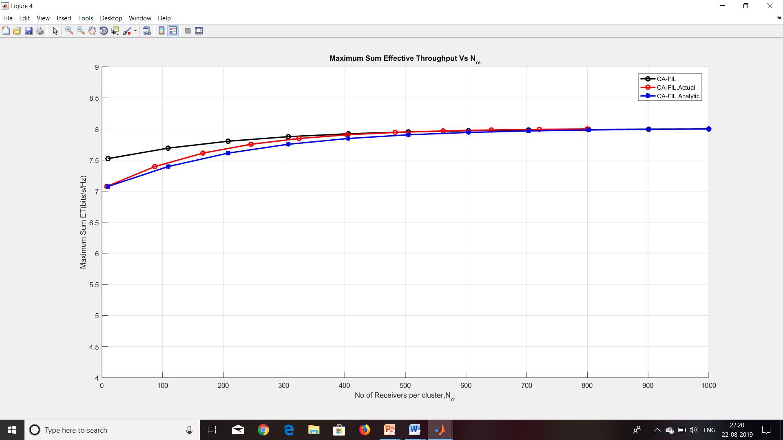
Comparison of Analytical and actual
ET values of CA-FIL

Slide 25
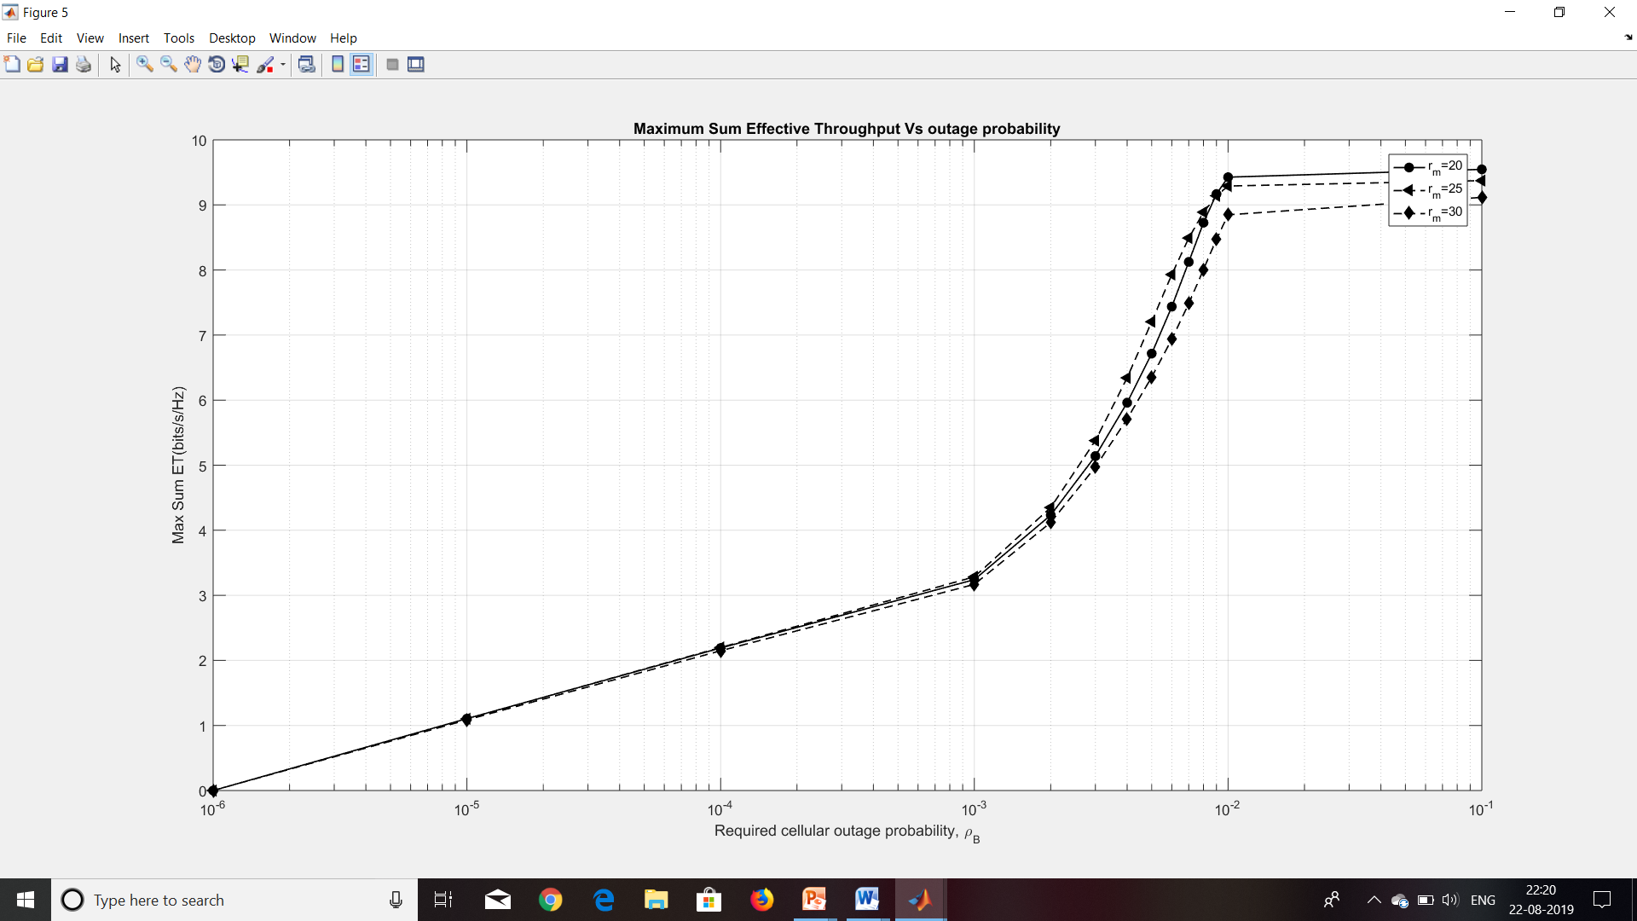
The ET versus outage probability for different Radii

Slide 26
References
[1] Multimedia Broadcast/Multicast Service (MBMS) User Service Guide- lines, document TR 26.946, 3GPP, 2007.
[2] M. Luby, T. Gasiba, T. Stock hammer, and M. Watson, ``Reliable multimedia download delivery in cellular broadcast networks,'' IEEE Trans. Broadcast., vol. 53, no. 1, pp. 235246, Mar. 2007.
[3] T.-P. Low, M.-O. Pun, Y.-W. Hong, and C.-C. J. Kuo, ``Optimized opportunistic multicast scheduling (OMS) over wireless cellular networks,'‘ IEEE Trans. Wireless Commun., vol. 9, no. 2, pp. 791801, Feb. 2010.

Slide 27


